Slide 1
Climate Economics
Dr Richard S.J. Tol MEA
Professor of the Economics of Climate Change
Vrije Universiteit Amsterdam
Professor of Economics
University of Sussex

Slide 2
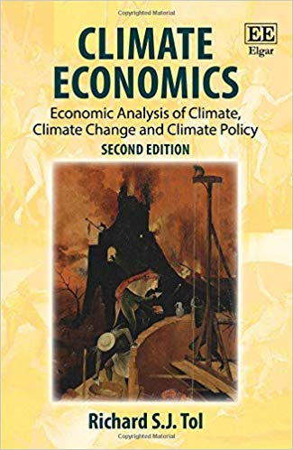
Contact
r.tol@sussex.ac.uk
Literature
Tol (2018) Climate Economics

Slide 3
My Lectures
1.11 Science, scenarios, abatement options
2.11 Costs of emission reduction
3.11 Valuation
Week 2 Impacts of climate change
Week 3 Optimal climate policy
Problem sets with Jaime
Steven will talk about international environmental agreements, and about international trade
Instruments for environmental policy are discussed by Caroline in Environmental Economics

Slide 4
Assessment
70% take-home exam
Note: We expect that you invest the same amount of time and effort into the take-home exam as you would in an unseen exam. Since you do not need to memorize or prepare for questions that aren’t asked, we expect much better answers.
30% essay
3000-4000 words
assessment of policy (proposal)
teams of N
3 workshops, led by Jaime, to get you started and help you out

